Slide 1

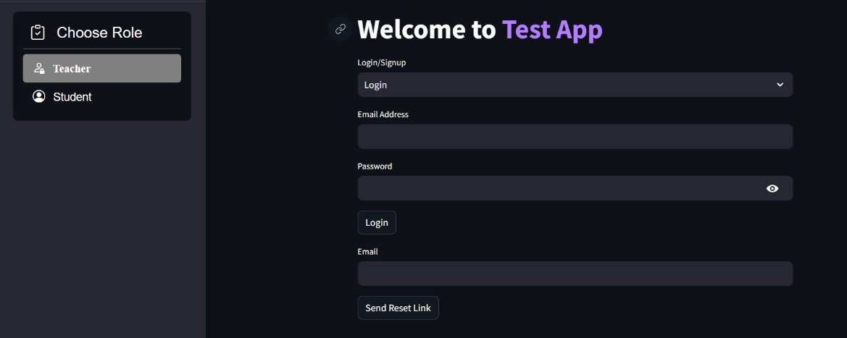
Automated Grading and Feedback System
To facilitate the process of educational assessments, our app will empower teachers to create and manage tests, view student performances, and offer students the ability to take tests and receive instant feedback on their performance. Integrated with an AI model that grades students and provides personalized feedback for each answer, our app assures unbiased and accurate grading. Ensuring accessibility and security, our app should be used across multiple devices, while securely storing everyone's data in the database. Our app aims to enhance the educational experience and streamline the assessment process, ensuring continuous student improvement.
SUMMER HACK

Slide 2



TEAM 11 HUMANS
Deepak Kumar Dash
(AI ML Dev)
Ritesh Kumar Panda
(AI ML Dev)
Ishita Pani
(AI ML Dev)
SUMMER HACK

Slide 3
PROBLEM STATEMENT:
In the current educational landscape, the process of creating, administering, and grading tests is often time-consuming, inconsistent, and prone to human bias. Traditional assessment methods fail to provide immediate feedback, hindering students' ability to quickly learn from their mistakes and improve. Additionally, maintaining the privacy and security of students' academic performance is a significant challenge, with many systems lacking data protection measures.
Educators need a streamlined, efficient, and secure solution to manage assessments, provide timely and personalized feedback, and ensure the integrity of student data. Students require a responsive system that supports their learning journey with instant insights and guidance. We can address these challenges by leveraging advanced AI technologies and modern web development techniques to create an innovative platform for seamless educational assessments.
SUMMER HACK

Slide 4
TECH STACK:
PROGRAMMING LANGUAGE: Python
FRONTEND: Flet
BACKEND: Python, Google Gemini API, Multi-Threading
DATABASE: Firebase, MongoDB
SUMMER HACK

Slide 5
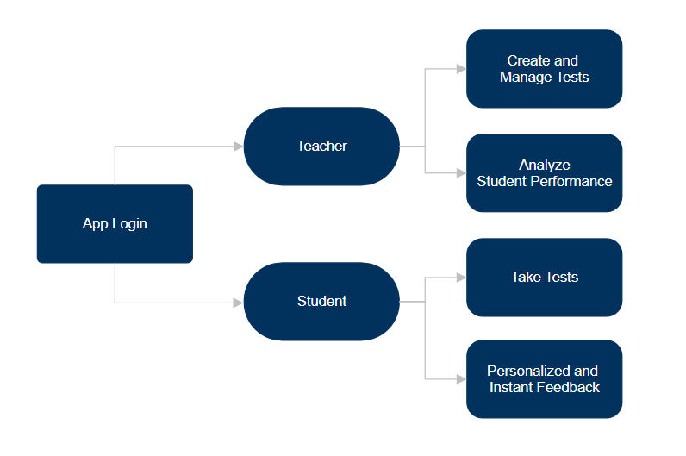
BLUEPRINT OF THE TOOL
SUMMER HACK

